Slide 1





Next Gen Employability Program
Full Stack Web Development with AI Tools
Team Id – NG_CP_Team_846
Name: Arjun Pundir
Name: Shaili Pundir
Name: Gagan Rana
College: Meerut Institute of technology, Meerut

Slide 2

Project Title
Finance Tracker
Manage Today, Secure Tomorrow.
Notes:
In this slide speaker will be introducing the program and its outcomes. The speaker will introduce himself in brief

Slide 3

Table of Contents
Introduction
Problem Statement
Proposed Solution
Key features
Technology stack
System flowchart
Core Modules
Conclusion and Future work
References
Notes:
This slide, The speaker will talk about the content that we will be covering in this session as follows:
Introduction
Importance of UI/UX in industry
History and Definitions of UI and UX
Key Differences between UI/UX
Use Cases
Significance in Web Development
Use Cases
Visual Design Principles
Design process
Color theory and psychology
Typography and readability
Layout and Spacing
Responsive design basics
Usability and Accessibility
Usability Aspects
Web Content Accessibility Guidelines (WCAG)
Inclusive design practices
Consistency
User Experience
User-Centered Design
User research methods
Interactive Elements and Feedback
Mini Case Study
Discussing a popular UI/UX design
Hands-On
Introduction to Figma for UI/UX design

Slide 4
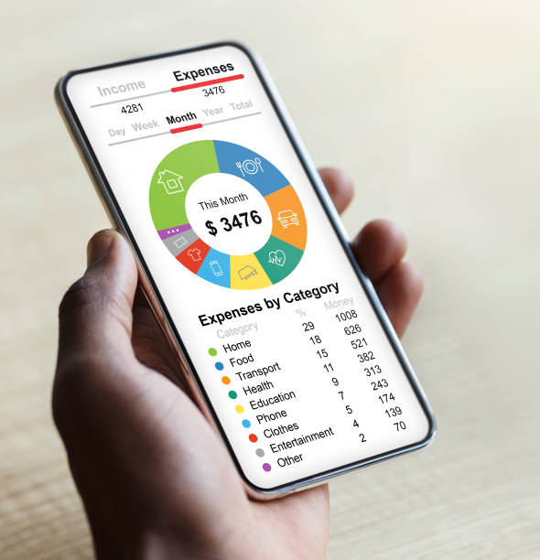
Introduction :
In today’s fast-paced digital world, managing personal finances efficiently is more important than ever. Traditional methods of tracking income and expenses through spreadsheets or paper records are time-consuming and prone to errors.
The Finance Tracker website offers a secure, user-friendly platform where users can register, log in, and manage their financial activities seamlessly. Users can add transactions, monitor cash flow, and view their financial dashboard, which provides instant insights and summaries.
Notes:
This slide, The speaker will talk about the content that we will be covering in this session as follows:
Introduction
Importance of UI/UX in industry
History and Definitions of UI and UX
Key Differences between UI/UX
Use Cases
Significance in Web Development
Use Cases
Visual Design Principles
Design process
Color theory and psychology
Typography and readability
Layout and Spacing
Responsive design basics
Usability and Accessibility
Usability Aspects
Web Content Accessibility Guidelines (WCAG)
Inclusive design practices
Consistency
User Experience
User-Centered Design
User research methods
Interactive Elements and Feedback
Mini Case Study
Discussing a popular UI/UX design
Hands-On
Introduction to Figma for UI/UX design

Slide 5

PROBLEM STATEMENT:
The existing financial management methods are manual, time-consuming, and prone to errors. Users often rely on notebooks, spreadsheets, or multiple applications, which makes tracking income and expenses inefficient and confusing.
The lack of real-time insights, budget control, and centralized data leads to poor cash flow management and weak financial decision-making.
There is a need for a secure, digital, and user-friendly finance tracking system that can accurately record transactions and provide instant financial insights.

Slide 6

KEY FEATURES:
The system provides a registration and login module that allows users to safely access their financial data.
Users can add and manage their income and expense transactions, which are stored in a centralized and secure database.
The dashboard displays financial summaries, cash flow status, and visual insights to help users understand their financial position.
This solution offers accurate tracking, improved budgetary control, better cash flow management, and enhanced decision-making. It reduces manual effort, minimizes errors, ensures data security, and improves overall financial management efficiency.
Notes:
This slide, The speaker will talk about the content that we will be covering in this session as follows:
Introduction
Importance of UI/UX in industry
History and Definitions of UI and UX
Key Differences between UI/UX
Use Cases
Significance in Web Development
Use Cases
Visual Design Principles
Design process
Color theory and psychology
Typography and readability
Layout and Spacing
Responsive design basics
Usability and Accessibility
Usability Aspects
Web Content Accessibility Guidelines (WCAG)
Inclusive design practices
Consistency
User Experience
User-Centered Design
User research methods
Interactive Elements and Feedback
Mini Case Study
Discussing a popular UI/UX design
Hands-On
Introduction to Figma for UI/UX design

Slide 7

PROPOSED SOLUTION:
1. User Login & Registration
2. Add and Manage Income & Expenses
3. Centralized Transaction Management
4. Financial Dashboard
5. Cash Flow Tracking & Budget Monitoring
6. Financial Reports & Insights
7. Fast, Reliable, and User-Friendly System

Slide 8
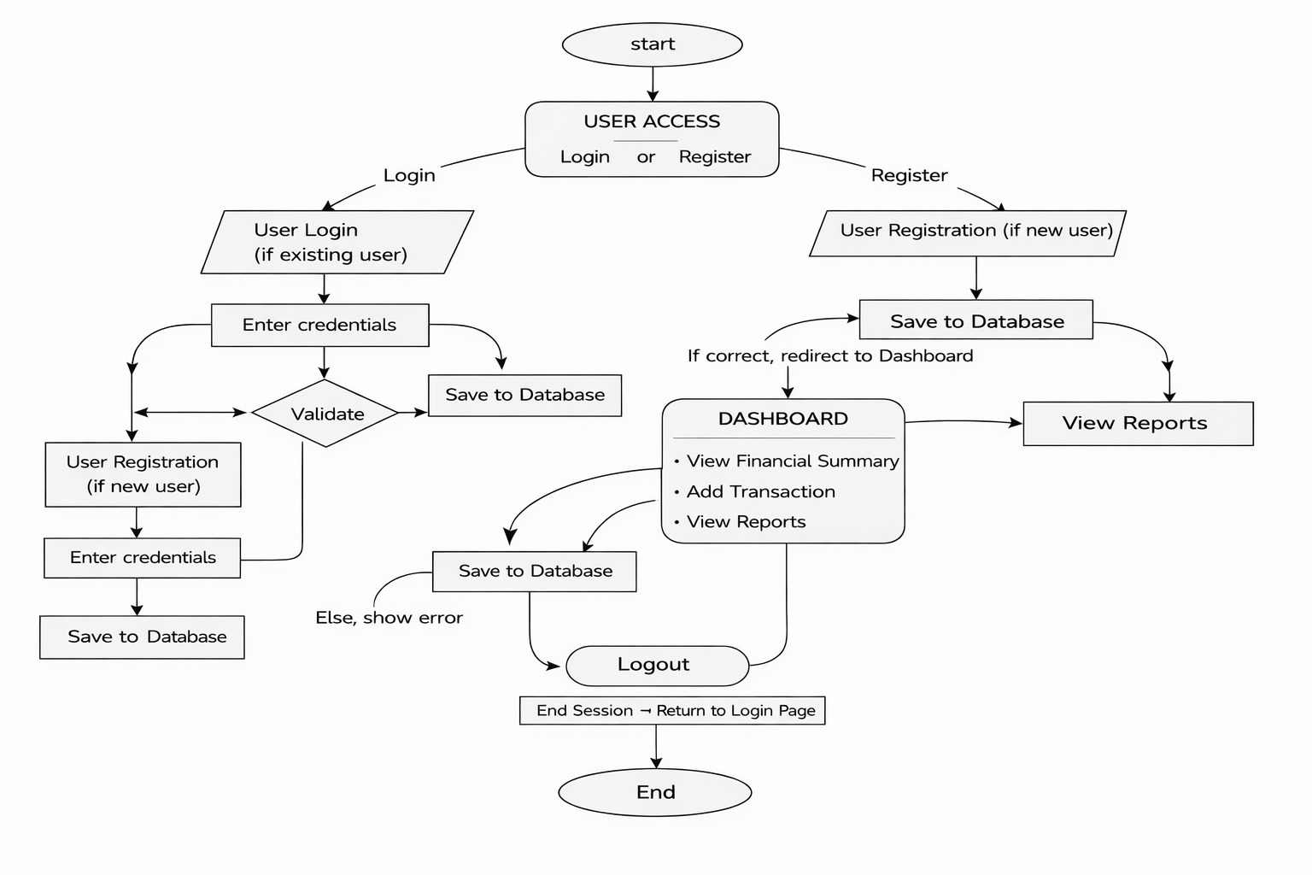
TECHNOLOGY STACK:
SYSTEM FLOWCHART :
1. Frontend:
HTML and CSS
2. Database :
SQLite3 (db.sqlite3) - secure storage of user and transaction data
3. Backend :
Python (Django) - Server-side logic and application framework
4. Tools & Environment:
Visual Studio Code – Code editor
Web Browser (Chrome/Edge) – Testing
Notes:
This slide, The speaker will talk about the content that we will be covering in this session as follows:
Introduction
Importance of UI/UX in industry
History and Definitions of UI and UX
Key Differences between UI/UX
Use Cases
Significance in Web Development
Use Cases
Visual Design Principles
Design process
Color theory and psychology
Typography and readability
Layout and Spacing
Responsive design basics
Usability and Accessibility
Usability Aspects
Web Content Accessibility Guidelines (WCAG)
Inclusive design practices
Consistency
User Experience
User-Centered Design
User research methods
Interactive Elements and Feedback
Mini Case Study
Discussing a popular UI/UX design
Hands-On
Introduction to Figma for UI/UX design

Slide 9
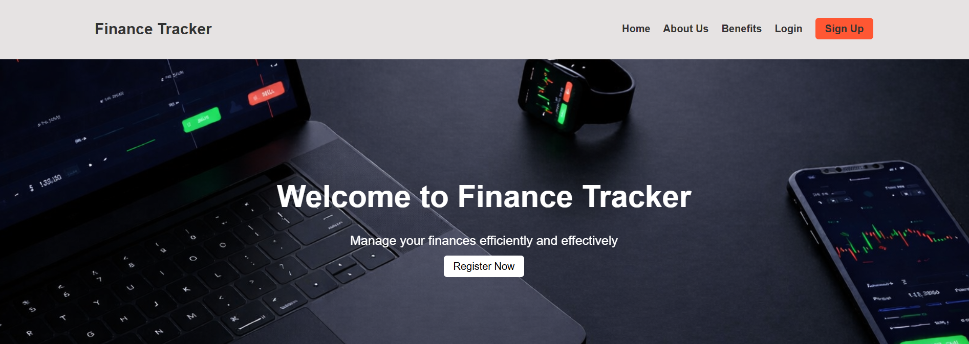
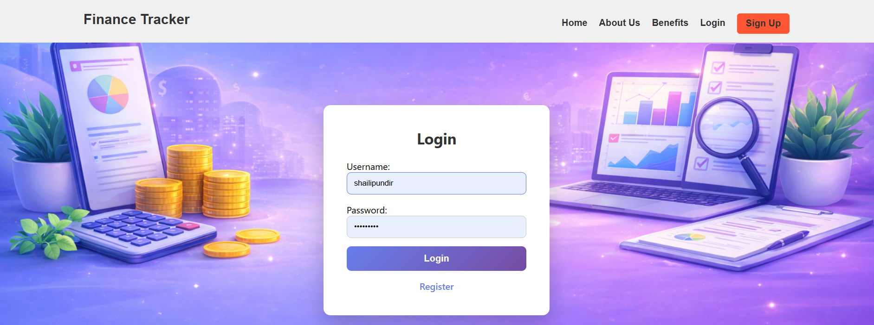
CORE MODULES:
Dashboard Module:
Displays real-time financial summaries, recods,
and insights such as cash flow, budget
utilization, and spending patterns.
Database Management Module:
Uses SQLite to securely store all
user and transaction data.
Category Management Module:
Add and edit categories helps in organizing transactions.
Security & Privacy Module:
Ensures data protection, secure access,
and privacy compliance, preventing
unauthorized access.
Notes:
This slide, The speaker will talk about the content that we will be covering in this session as follows:
Introduction
Importance of UI/UX in industry
History and Definitions of UI and UX
Key Differences between UI/UX
Use Cases
Significance in Web Development
Use Cases
Visual Design Principles
Design process
Color theory and psychology
Typography and readability
Layout and Spacing
Responsive design basics
Usability and Accessibility
Usability Aspects
Web Content Accessibility Guidelines (WCAG)
Inclusive design practices
Consistency
User Experience
User-Centered Design
User research methods
Interactive Elements and Feedback
Mini Case Study
Discussing a popular UI/UX design
Hands-On
Introduction to Figma for UI/UX design

Slide 10
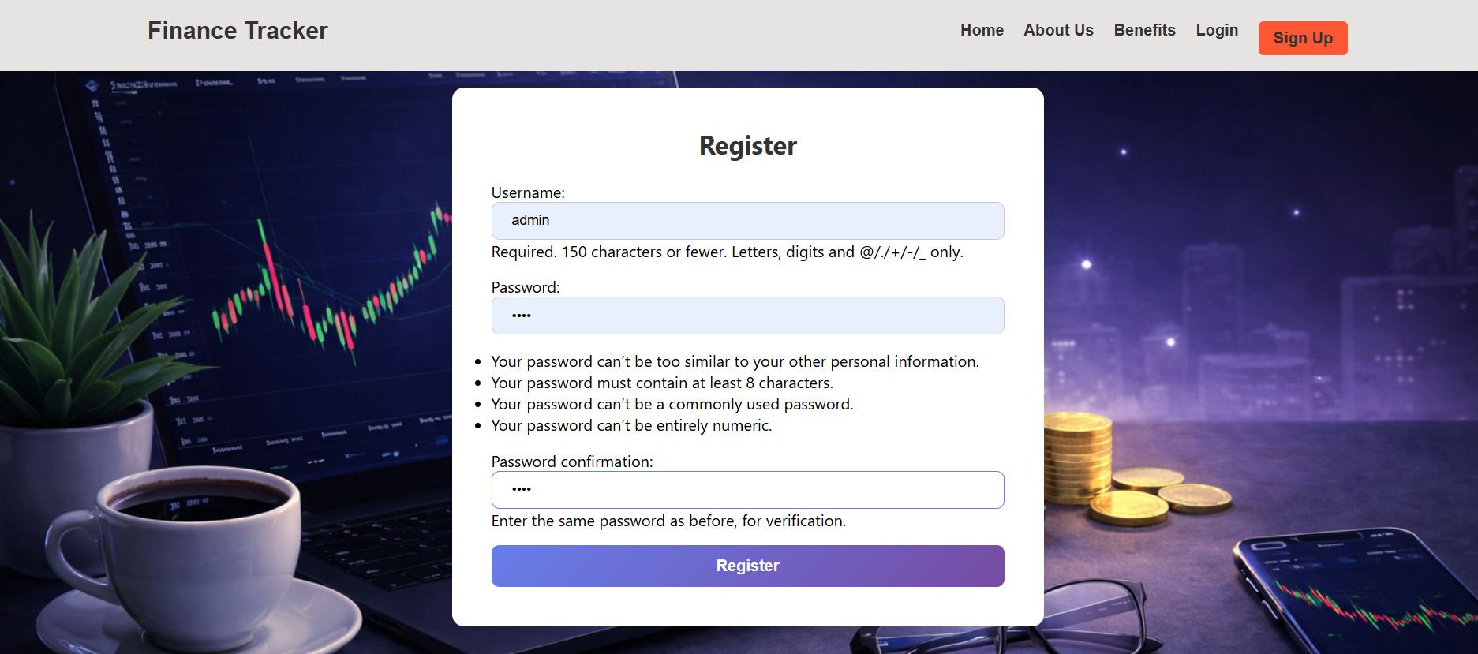
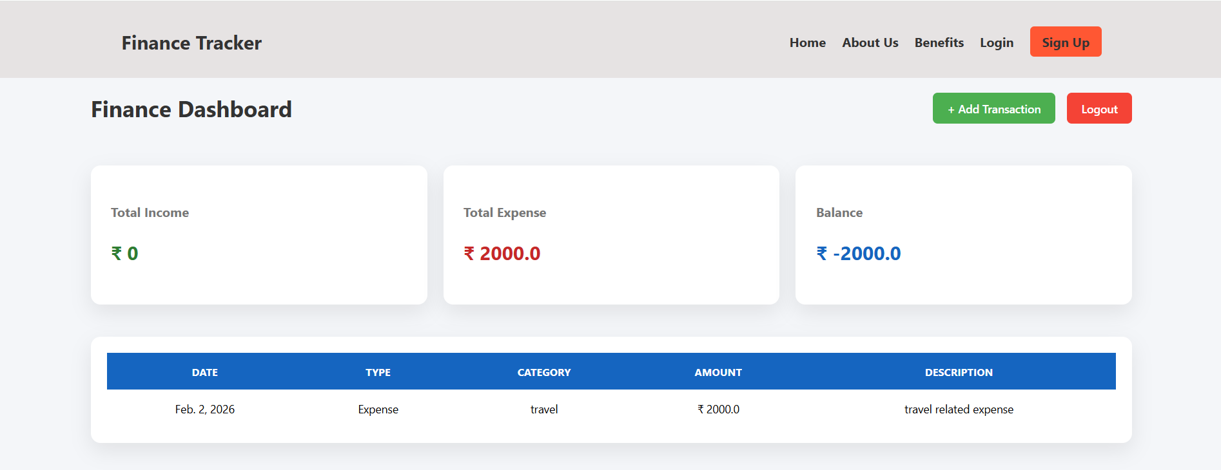
CONCLUSION AND FUTUREWORK:
The Finance Tracker provides a fast, secure, and reliable method for managing personal finances.
It eliminates manual record-keeping and reduces errors in tracking income, expenses, and budgets.
The system ensures real-time financial insights, improves cash flow management, and supports informed decision-making.
Finance Tracker simplifies financial management by offering instant insights, accurate tracking, and better control over personal finances.
With a user-friendly interface and centralized data storage, it is suitable for students, professionals, and small organizations.
Notes:
This slide, The speaker will talk about the content that we will be covering in this session as follows:
Introduction
Importance of UI/UX in industry
History and Definitions of UI and UX
Key Differences between UI/UX
Use Cases
Significance in Web Development
Use Cases
Visual Design Principles
Design process
Color theory and psychology
Typography and readability
Layout and Spacing
Responsive design basics
Usability and Accessibility
Usability Aspects
Web Content Accessibility Guidelines (WCAG)
Inclusive design practices
Consistency
User Experience
User-Centered Design
User research methods
Interactive Elements and Feedback
Mini Case Study
Discussing a popular UI/UX design
Hands-On
Introduction to Figma for UI/UX design

Slide 11
References :
https://www.chatgpt.com/
https://gemini.google.com/
https://copilot.microsoft.com/
https://www.canva.in/
Notes:
This slide, The speaker will talk about the content that we will be covering in this session as follows:
Introduction
Importance of UI/UX in industry
History and Definitions of UI and UX
Key Differences between UI/UX
Use Cases
Significance in Web Development
Use Cases
Visual Design Principles
Design process
Color theory and psychology
Typography and readability
Layout and Spacing
Responsive design basics
Usability and Accessibility
Usability Aspects
Web Content Accessibility Guidelines (WCAG)
Inclusive design practices
Consistency
User Experience
User-Centered Design
User research methods
Interactive Elements and Feedback
Mini Case Study
Discussing a popular UI/UX design
Hands-On
Introduction to Figma for UI/UX design

